Slide 1
Final Project Presentation
Mages Institute of Excellence
DS102 - DS104
Au Yuh Jiin

Slide 2
Inspiration
I’m always curious about an ordinary millennials can earn money and fame by produce their own video on Youtube and gain millions of followers.
It can act as megaphone, bringing messages to the masses, and becoming an influential voice in the global cultural conversation. It only also help brands in multiple ways. - Online quote
You get people on YouTube pursuing their passions and interests. It’s a very personal time. YouTube is pull, and pull is better than push for a brand, they’re actively telling you what’s on their mind - Dr Tom Chatfield, Tech Philosopher
I chose Singapore Youtuber as it’s relate to us and would like to study the resonance effect, they can always be a brand ambassador or a product spokesperson.

Slide 3
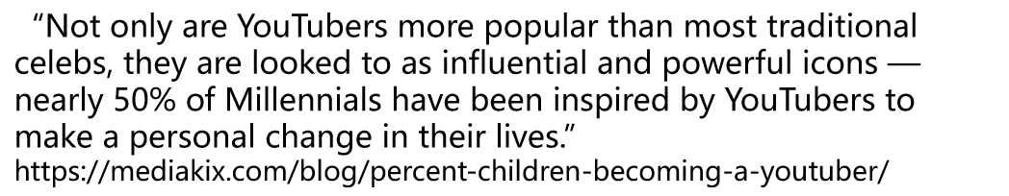
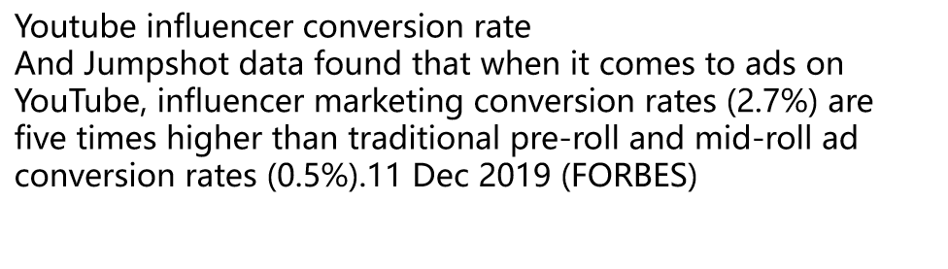
Why YouTube

Slide 4
Top 10 Youtuber in Singapore
As per socialbakers.com and socialblade.com ranking, I chose 3 comedians to do a comparison data analysis.

Slide 5
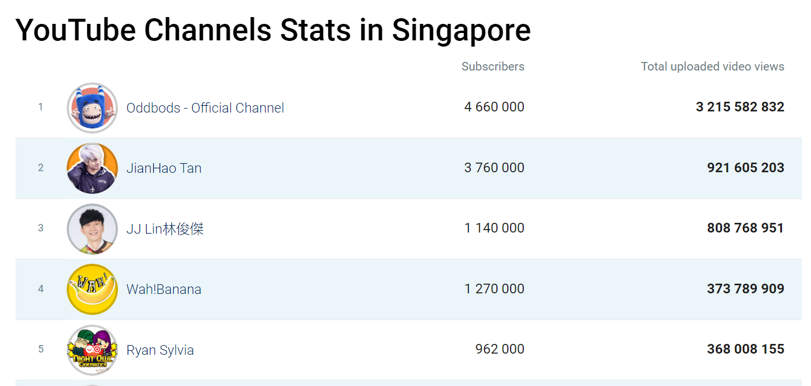
Source from socialbakers.com

Slide 6
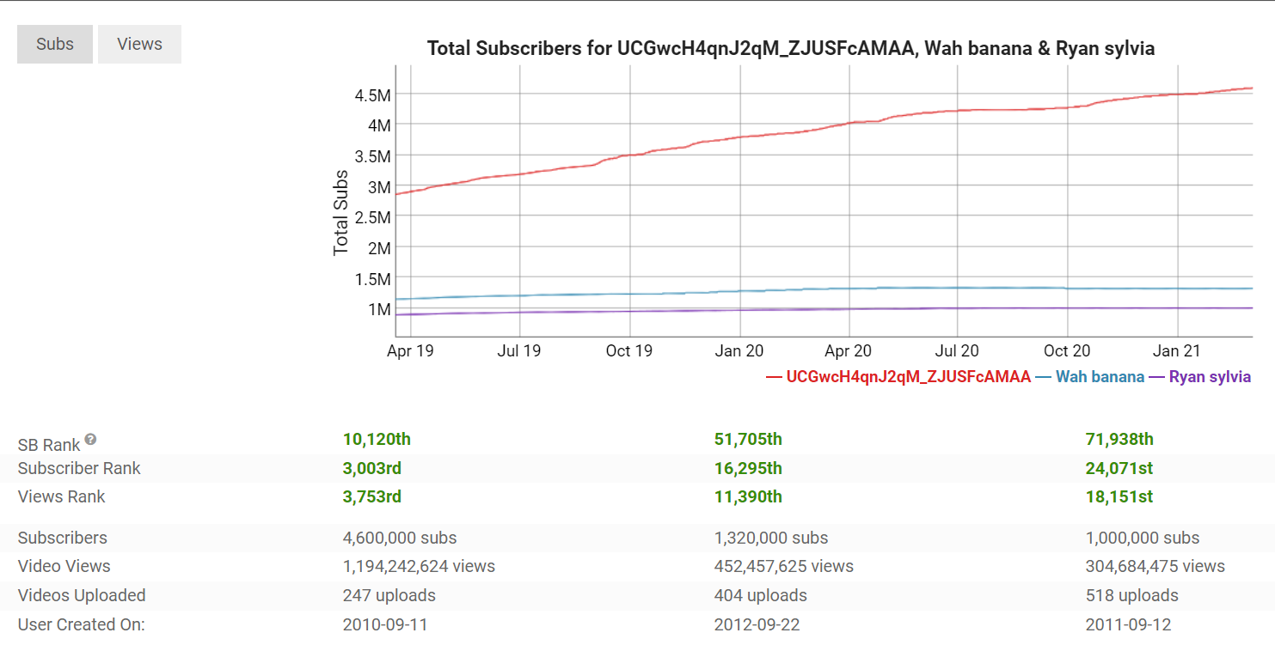
Source from socialblade.com

Slide 7
Analyise the reason / correlation behind these young Youtubers video
What is their most popular video?
What is the total amount of channel views?
What is overall “theme” of their channel?
How many videos they have uploaded?
Does this person have an uploading schedule?
Based on their last 10 videos, what is the average length of their video?
Which Youtuber/Channel had the most trending videos, likes, comments and dislikes?
Which video category ranked up the most views, likes and comments?
How are views, likes, dislikes, comments count and video length correlate with?
When were the videos uploaded? On which days of the week and time? Will these factors affect the views?
Among 3 of them, which have most views and subscribers and why?

Slide 8

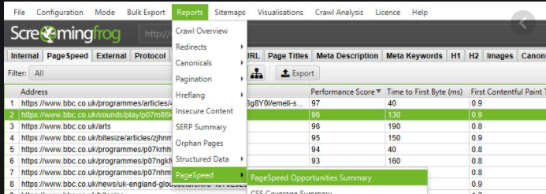

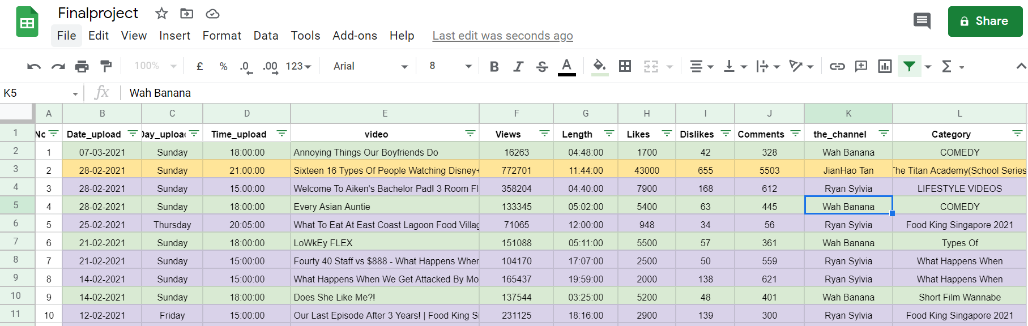
Data Source

Slide 9
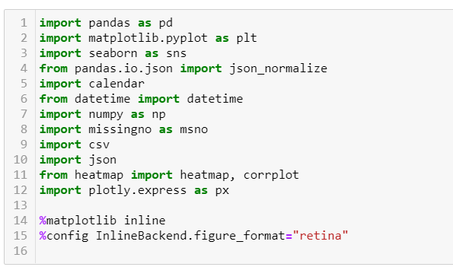
Prepare the environment

Slide 10
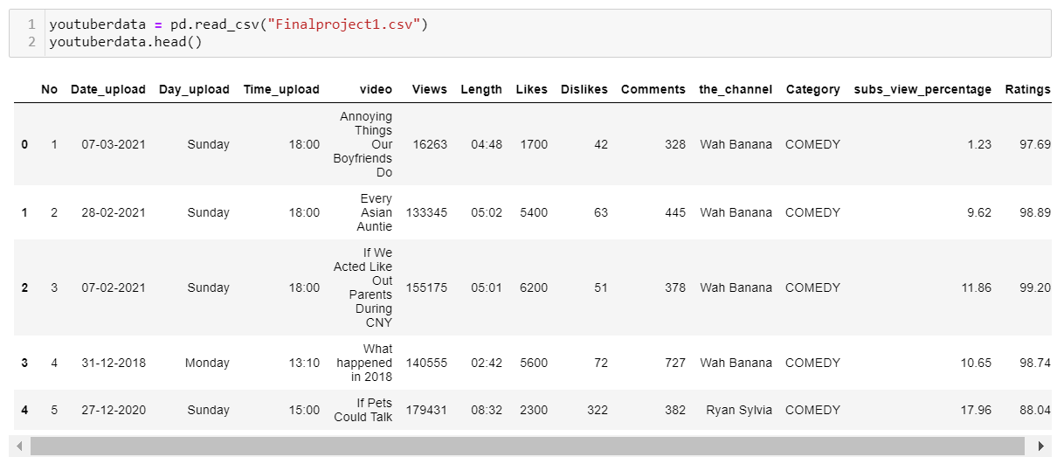
Read and examine the Dataset
(2018 - 2021)

Slide 11
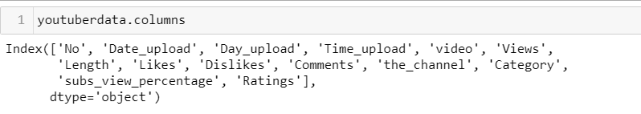
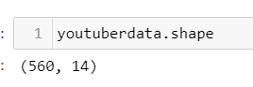
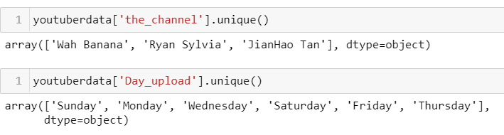
Understanding Data
So we have
560 rows and 14 columns
Date upload
Day upload
Time upload
video
Views
Length
Likes
Dislikes
Comments
the_channel
Category
subs_view_percentage
Ratings

Slide 12
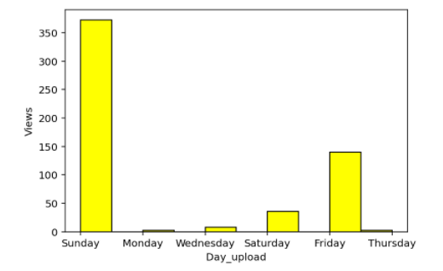
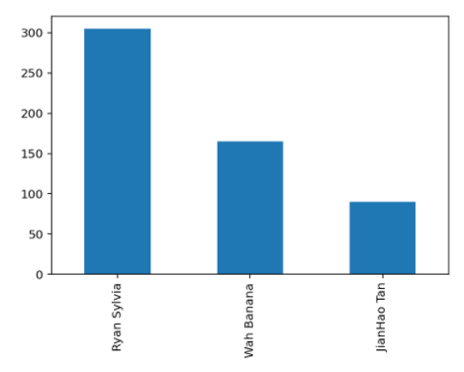
Exploring and visualizing data

Slide 13
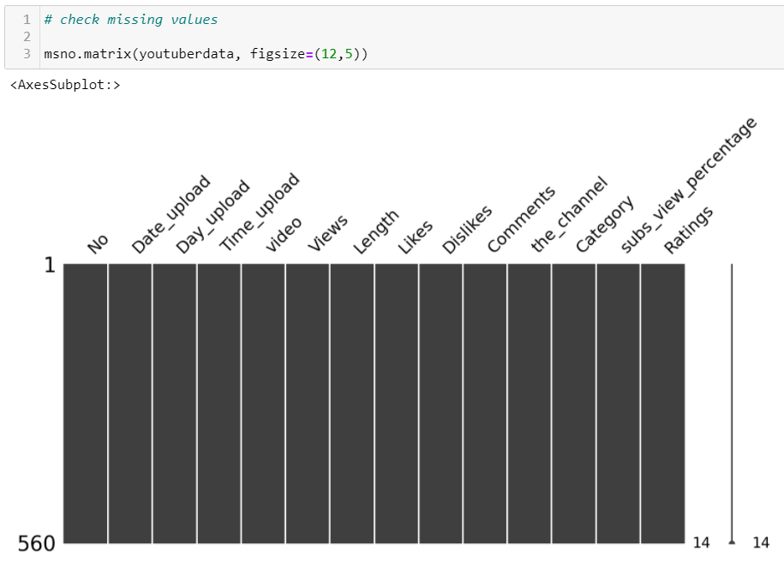
Exploring and visualizing data

Slide 14
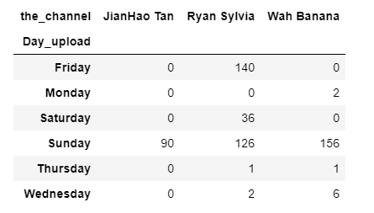
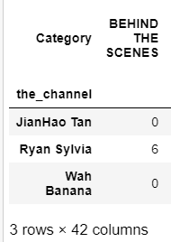
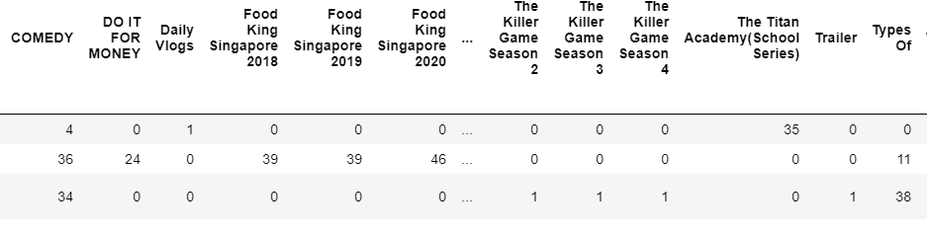
Exploring and visualizing data

Slide 15
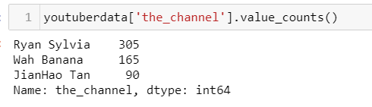
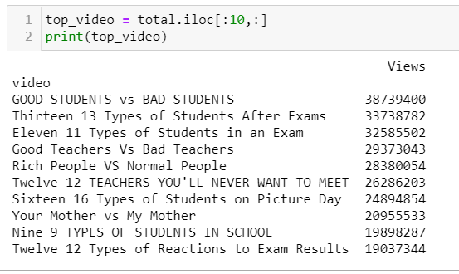
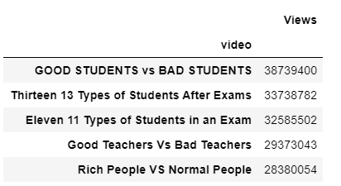
Exploring and visualizing data
Mort viewed videos are from Jian Hao Tan even his total numbers of videos uploaded rank 3rd. Top views/popular videos are which took place in a school context.

Slide 16
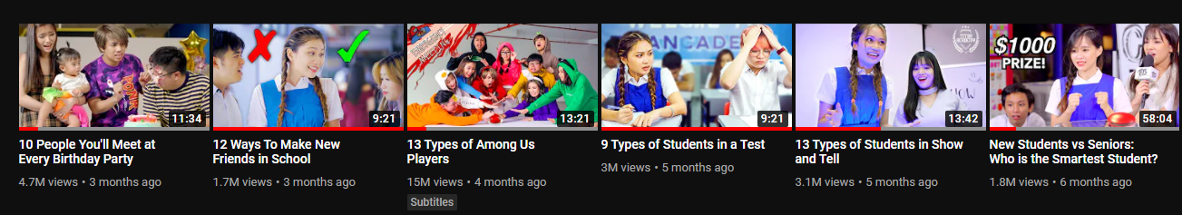
Some of his most viewed videos

Slide 17
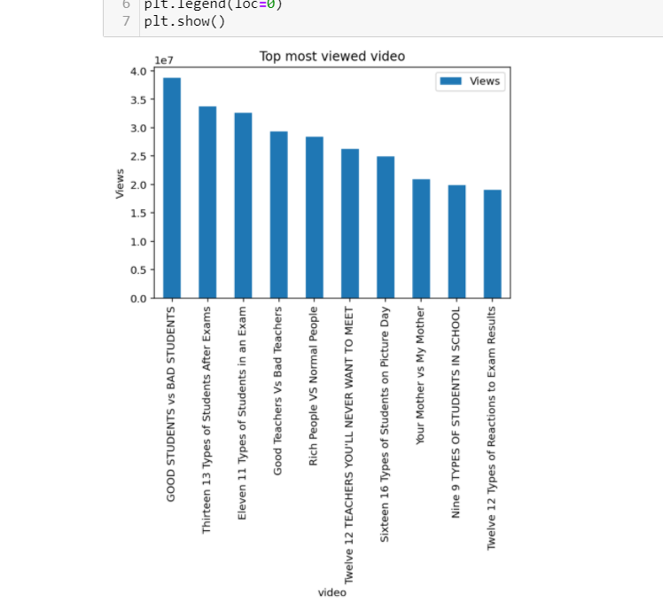
Exploring and visualizing data

Slide 18
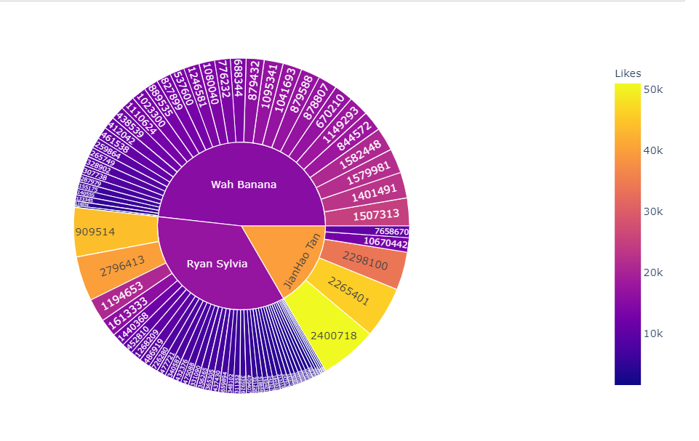
Exploring and visualizing data

Slide 19
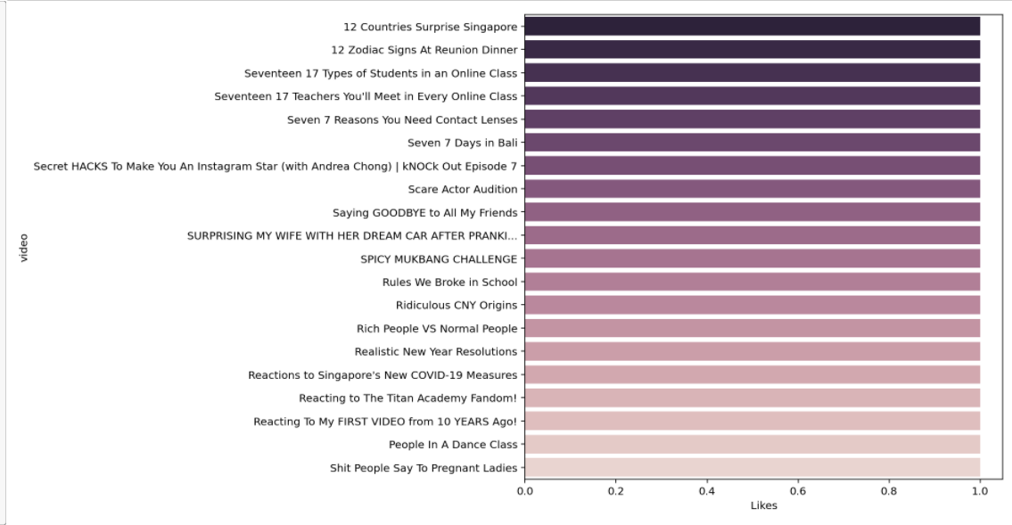
Exploring and visualizing data

Slide 20
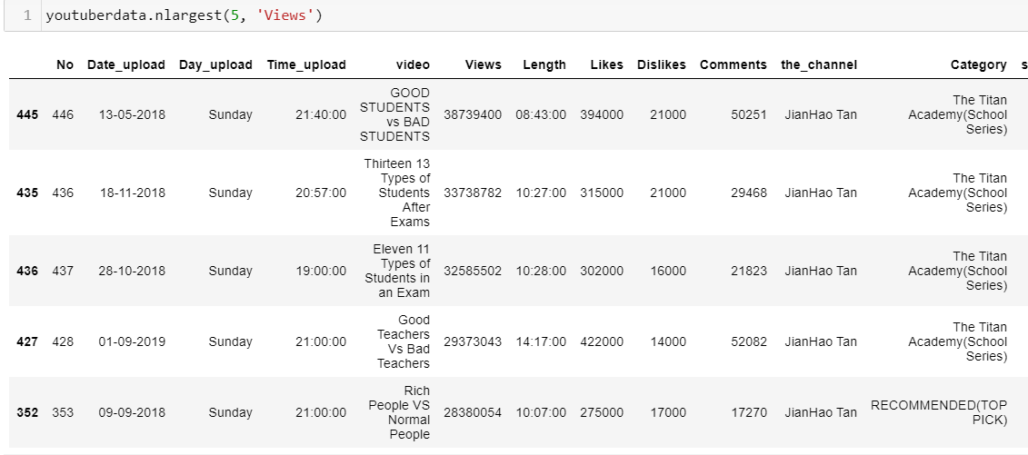
Exploring and visualizing data

Slide 21

Fix upload time, short video. Consistency
Insights
Localize
Resonance
More videos does not equal to more views/likes
Sunday night is the good day to upload new video (more viewers)
Title keyword - short and sharp

Slide 22
THANK YOU

